Slide 1

AtliQ Hardware
Consumer Goods Ad_Hoc Insights

Slide 2
Objectives
Analyze AtliQ Hardware's sales database using MySQL to answer 10 business-critical questions related to markets, products, customers, manufacturing costs, and sales performance.
Evaluate product growth, customer discount patterns, monthly and quarterly trends, and sales channel contribution.
Identify top-performing products across divisions and compare manufacturing costs to support product-level evaluation.
Translate SQL query results into actionable business insights for management and sales teams.
Demonstrate practical SQL skills using joins, aggregations, CTEs, subqueries, and window functions.

Slide 3
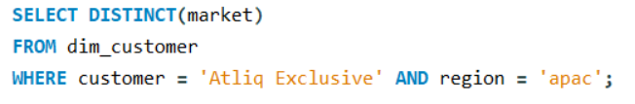
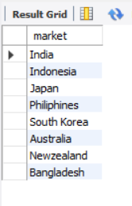
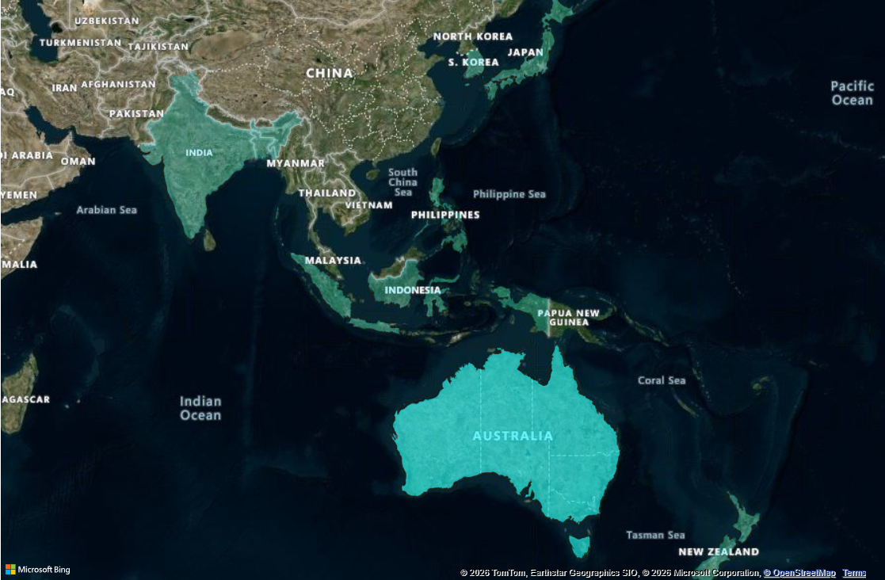
"Atliq Exclusive" businesses in the APAC region

Slide 4
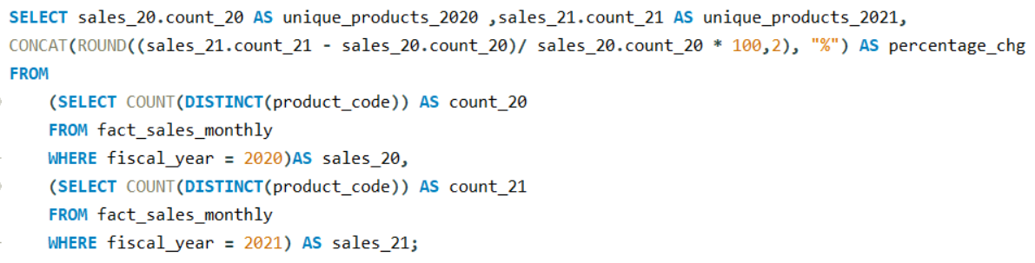
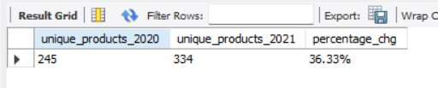
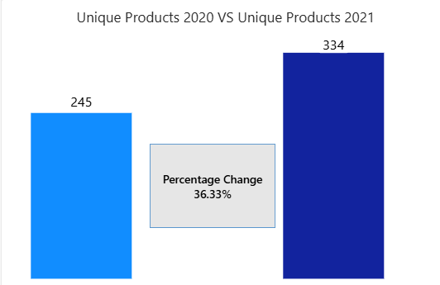
Percentage of unique product increase in 2021 vs. 2020

Slide 5
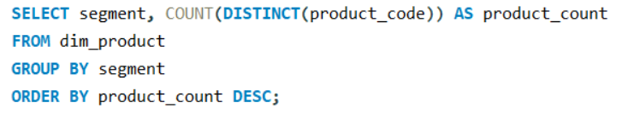
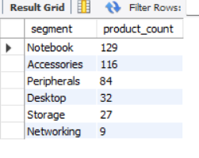
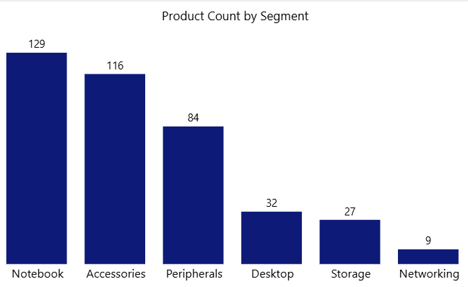
A report with all the unique product counts for each segment

Slide 6
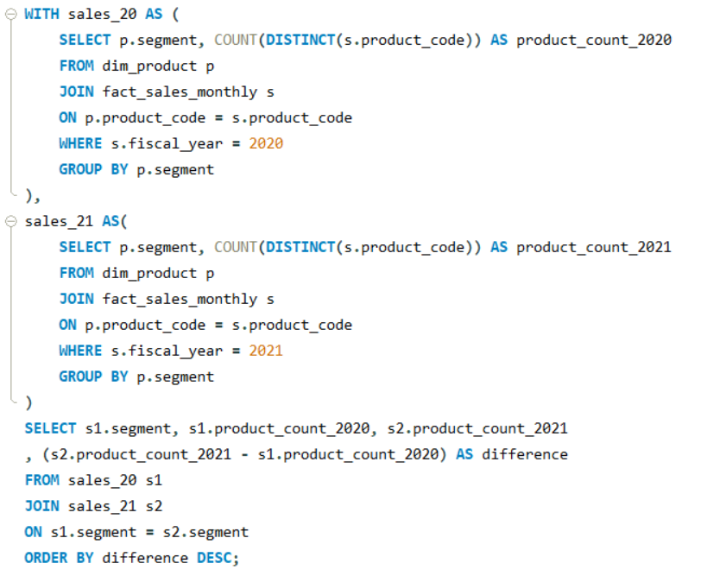
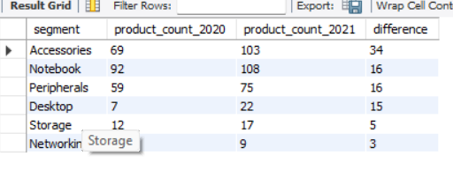
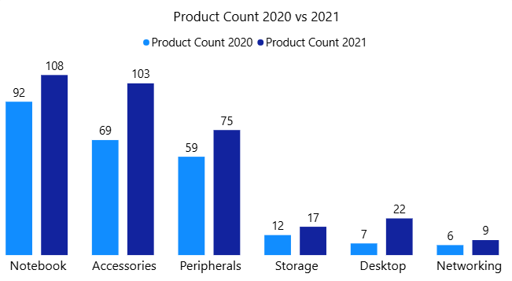
A segment with most increase in unique products in 2021 vs 2020

Slide 7
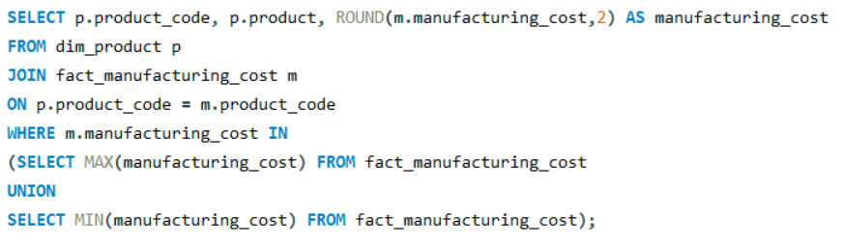

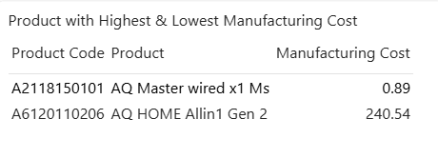
Products that have the highest and lowest manufacturing costs

Slide 8
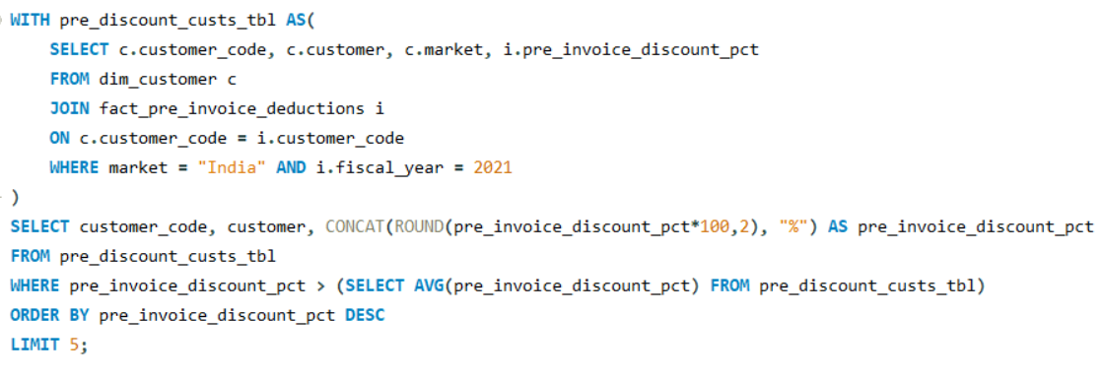
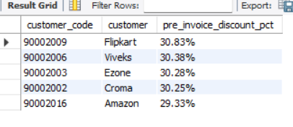
A report which contains the top 5 customers who received an above average pre_invoice_discount_pct for the fiscal year 2021 and in the Indian market

Slide 9
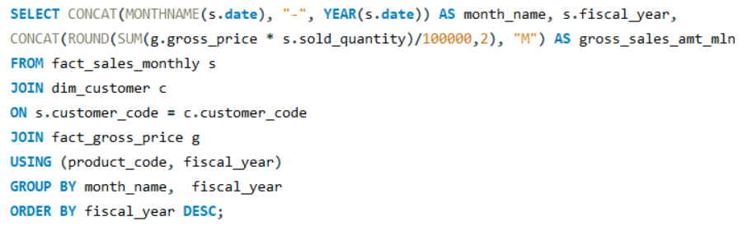
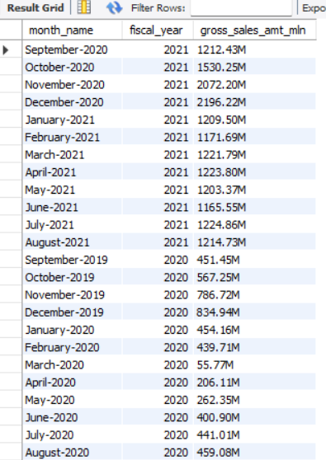
A report of the Gross sales amount for the customer “Atliq Exclusive” for each month

Slide 10
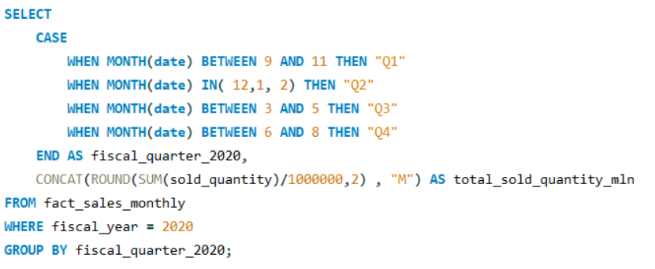
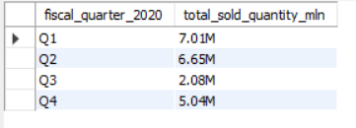
The quarter of 2020, with maximum total_sold_quantity

Slide 11
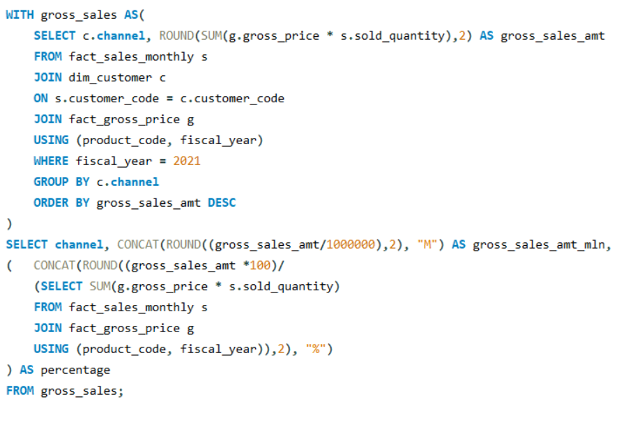
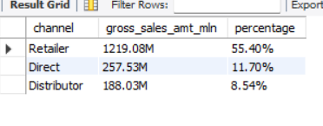
Channels and their gross sales in the fiscal year 2021 and their percentage of contribution

Slide 12
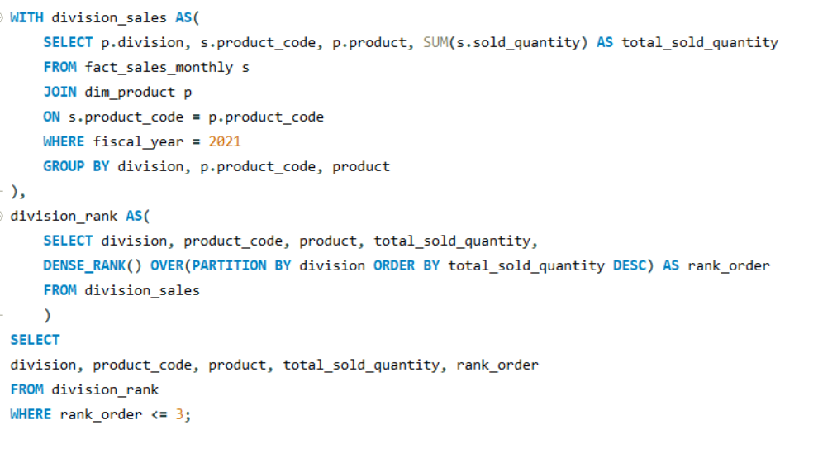
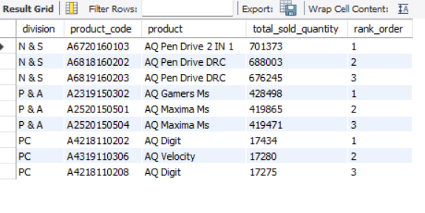
Top 3 products in each division that have a high total_sold_quantity in the fiscal_year 2021

